Slide 1
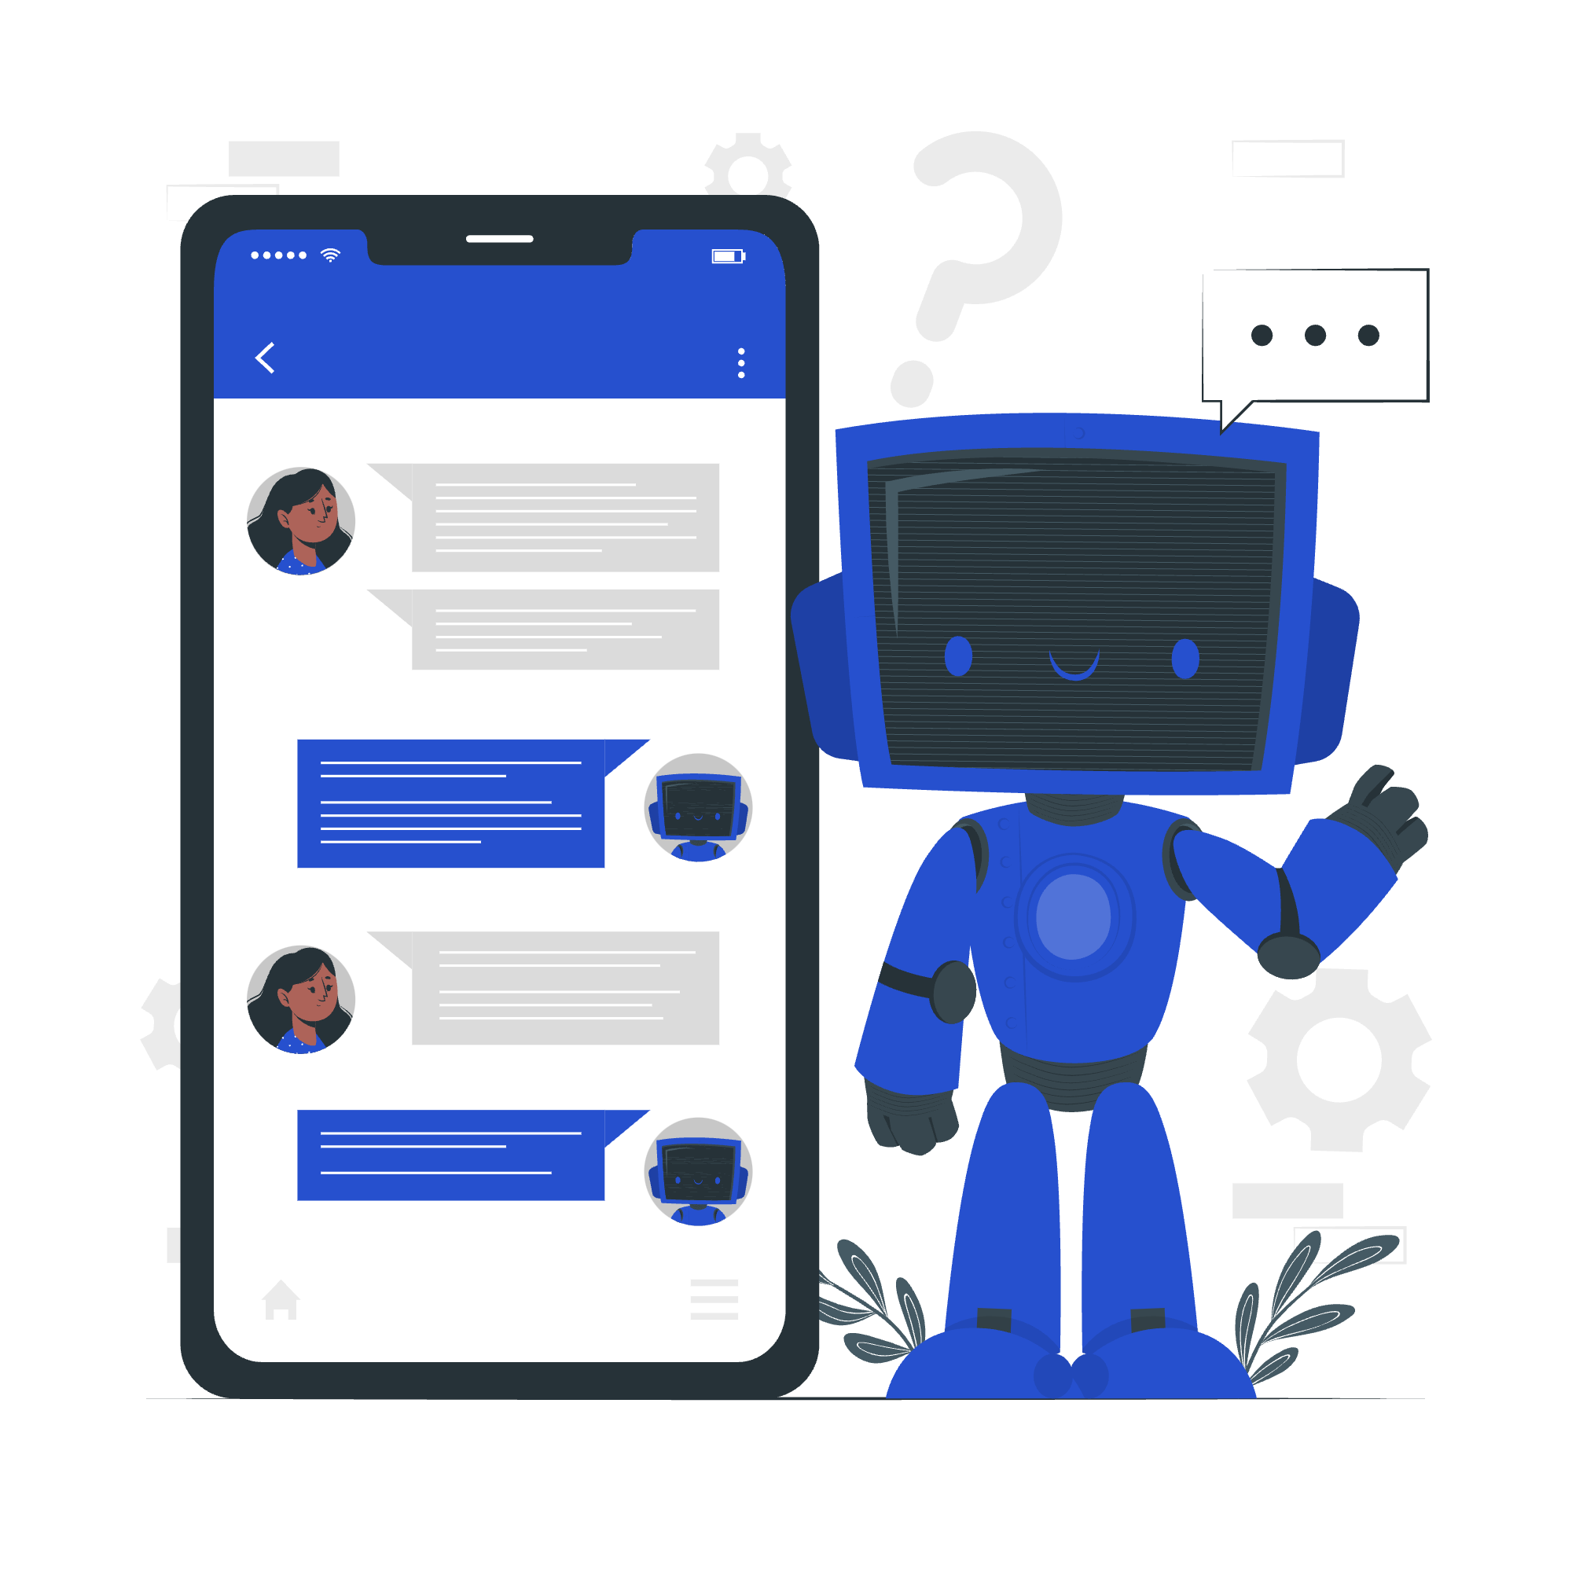

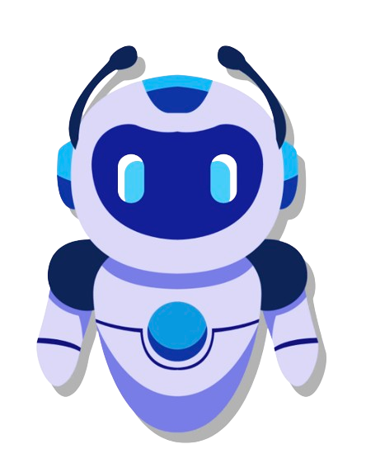

Neural Nets (FirstAidGenie)
vs
ChatGPT
Group No. 03
PAGE
1

Slide 2









Introducing the Team :
THANESH NAGARAJAN
(PROTOTYPER)
VAIBHAV PARIKH
(PROTOTYPER)
CHINTAN PATADIA
(DESIGNER)
PRIYAMVADA MURUDKAR
(DESIGNER)
JUMAINA RAHMAN NEEN
(EDITOR)
FORAM PATEL
(EDITOR)
POOJA PALA
(LIBRARIAN)
GURVEEN NAGPAL
(LIBRARIAN)
PAGE
2

Slide 3
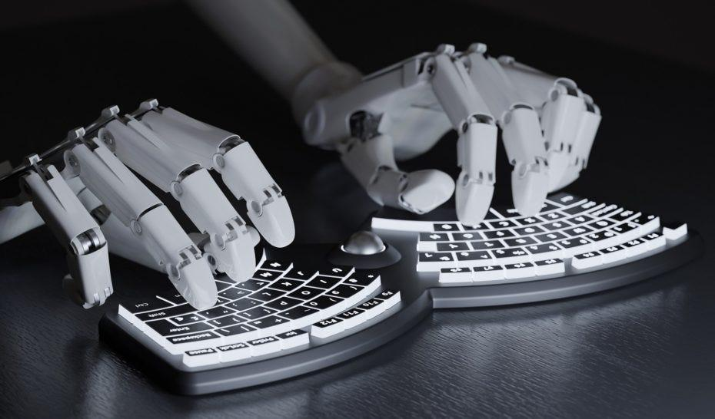
Introduction
We aim to compare between two advanced chatbot models, Neural Net using BioBERT and ChatGPT
we will delve into the problem statement, discussing the importance of conversational chatbots for first aid recommendations and the target application of our project.
review existing solutions in the field of conversational chatbots, highlighting the pros and cons of popular models.
provide an overview of our two chatbot models, Neural Net using BioBERT and ChatGPT, detailing their design and features.
we will present the findings of our comparison, analyzing the accuracy, usability, and coverage of first aid recommendations provided by each chatbot.
PAGE
3

Slide 4
Problem Statement :
01
02
Access to immediate and accurate medical assistance during emergencies is paramount.
Individuals may not always have access to trained medical professionals in such situations.
03
04
Our project addresses this challenge by focusing on conversational chatbots tailored for first aid recommendations.
The goal is to develop chatbots capable of comprehending emergency scenarios and providing precise guidance.
05
06
Aims to empower individuals to assess situations, identify injuries or symptoms, and administer appropriate first aid measures before professional medical assistance is available.
The significance of this endeavor lies in bridging the gap between emergency situations and expert medical care, potentially saving lives in critical moments.
PAGE
4

Slide 5
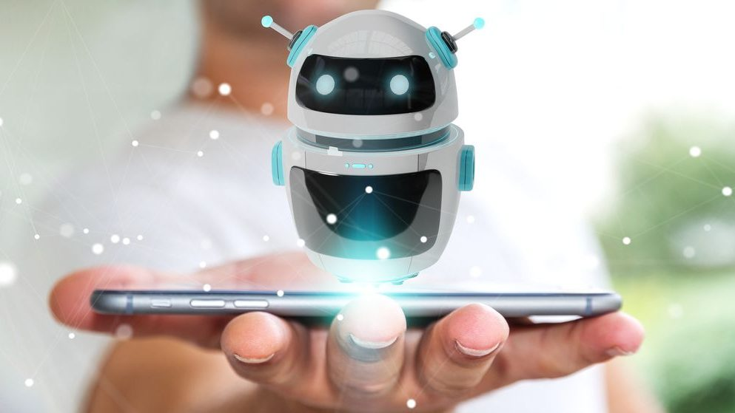

Existing Solutions
Seq2Seq Model :
In the landscape of conversational chatbot solutions, several models have emerged, each with distinct architectures and functionalities. One such model is the Seq2Seq model, which excels in tasks like dialogue generation and text summarization. Its flexibility allows it to handle various conversational tasks effectively. However, these models are susceptible to bias, as they may generate unrealistic responses due to dataset imbalances, and they may struggle with understanding contextual information, leading to irrelevant responses.
Transformer-based Model :
It's known for its self-attention mechanism that enables parallel processing and scalability. These models can efficiently train on modern hardware, making them suitable for handling large datasets and vocabularies. Nevertheless, Transformer-based models may lack interpretability, making it challenging to understand the underlying reasons behind their generated responses. Moreover, they require substantial data and computational resources for training, which can be a limiting factor in some scenarios.
PAGE
5

Slide 6
Existing Solutions
LSTM (Long Short-Term Memory) :
LSTM, or Long Short-Term Memory, is another type of model commonly used in conversational chatbots. LSTMs are well-suited for processing sequences with long-range dependencies and address the vanishing gradient problem encountered in training deep networks. However, they are prone to overfitting when trained on insufficient data and may require extensive training times, particularly on large datasets.
PAGE
6

Slide 7
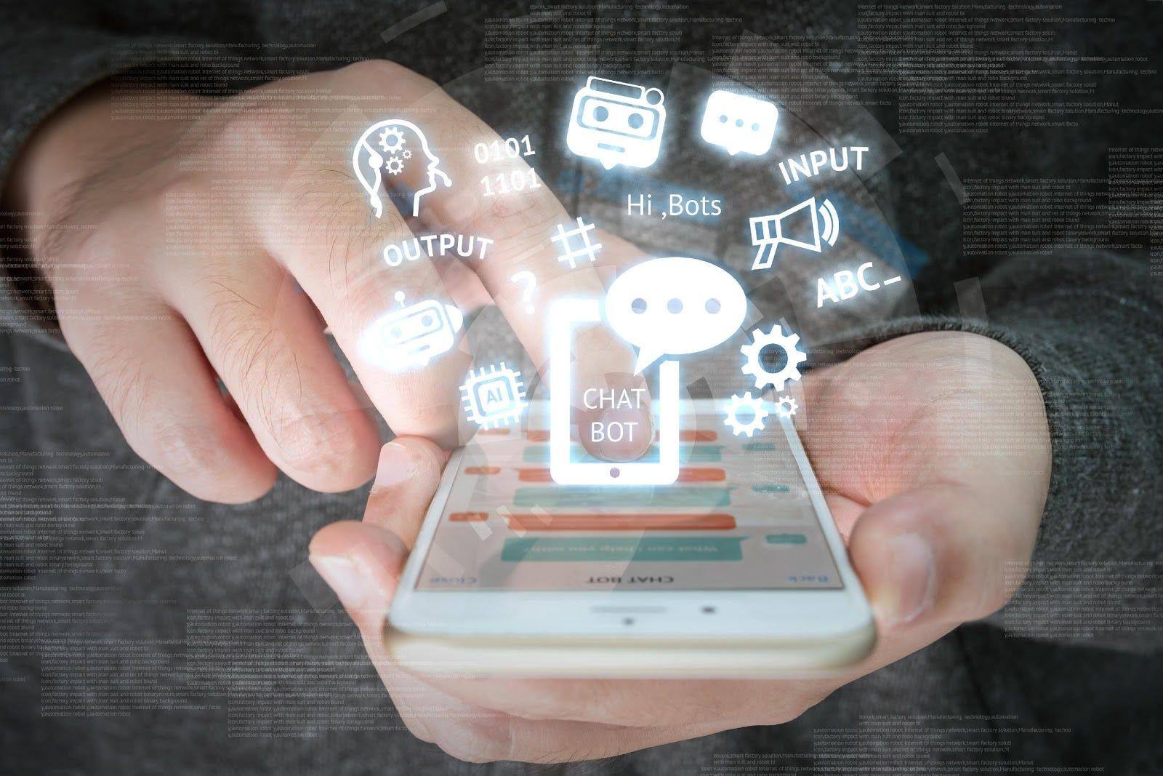

ChatBot Overview
We focus on comparing two powerful conversational chatbots: Neural Net using BioBERT and ChatGPT
These chatbots are designed to provide first aid recommendations, catering to the critical need for immediate medical assistance in emergency situations.
Both chatbots serve a crucial role in providing timely and accurate medical guidance
While Neural Net using BioBERT offers specialized insights tailored to biomedical contexts, ChatGPT excels in its broad conversational capabilities, offering flexibility and versatility in engaging with users.
We aim to evaluate their effectiveness and usability in delivering first aid recommendations
PAGE
7

Slide 8
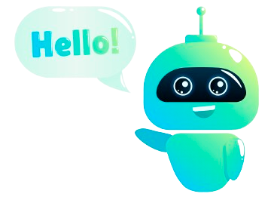
Neural Net using BioBERT
we have developed a chatbot based on Neural Net using
BioBERT, which integrates BioBERT, a specialized version
of BERT (Bidirectional Encoder Representations from
Transformers), with a neural network framework.
The Neural Net using BioBERT chatbot leverages the BioBERT
model, pre-trained on biomedical text data, to understand
and process medical inquiries effectively.
Architecture:
Input Processing
Intent Classification
Response Generation
Features:
BioBERT Integration
Intent-Based Response Generation
User Interface Options
PAGE
8

Slide 9

Chat-GPT
ChatGPT is an advanced conversational AI model that generates human-like text responses, facilitating natural language interactions
across a wide array of applications, from customer service to
educational support. With its ability to understand context and
generate coherent replies, ChatGPT revolutionizes
human-computer communication, offering unparalleled
versatility and efficiency.
we fine-tune ChatGPT to provide precise and contextually
relevant first aid recommendations, catering to the critical
need for immediate medical assistance in emergency situations.
Features:
GPT Architecture
Fine-Tuning
User Interface
PAGE
9

Slide 10
Comparison and Analytics
ChatGPT :
Understanding complicated questions
Accuracy in the answers
Calculation cost
Pre-training Dataset
Neural Nets :
Understanding complicated questions
Accuracy in the answers
Calculation cost
Pre-training Dataset
PAGE
10

Slide 11




Plans for Improvement
Data Augmentation
Multi-lingual Support
Continuous Monitoring and Feedback Mechanisms
User Interface Enhancements
Model Refinement
Incorporating synonyms, word variations, and paraphrases of existing patterns, we can provide the chatbots with a more diverse set of training examples for each intent.
We aim to implement multi-lingual support, allowing users to interact with the chatbots in their preferred language.
we intend to implement continuous monitoring and feedback mechanisms to gather insights into the performance of our chatbots and identify areas for further improvement.
we aim to refine the models used in our chatbots to enhance their performance and responsiveness.
We plan to incorporate user-friendly features and design elements into the interface, making it easier for users to interact with the chatbots and access relevant information quickly.
PAGE
11

Slide 12
Highlights of Chatbots' Capabilities
Neural Nets using BioBERT :
Specialized Medical Knowledge
Precise Recommendations
Semantic Similarity
possesses specialized knowledge in medical and healthcare subjects, particularly in the context of first aid.
chatbot can comprehend and react to medical queries with a high degree of precision, offering tailored recommendations suited to specific illnesses or injuries.
chatbot can accurately match user inquiries with predefined intent patterns and provide contextually relevant responses.
ChatGPT :
Versatile Conversational Abilities
Contextual Understanding
Accessibility
ChatGPT excels in engaging in human-like conversations across a wide range of topics, including first aid recommendations.
ChatGPT can understand and respond to user inquiries with contextual relevance, offering detailed instructions and guidance tailored to emergency situations.
With its user-friendly interface and intuitive interaction capabilities, it provides accessible and easy-to-understand assistance to users seeking first aid advice,.
PAGE
12

Slide 13

PAGE
13

Slide 14

References
[1] Lee, J., Yoon, W., Kim, S., Kim, D., Kim, S., So, C. H., & Kang, J. (2019, September 10).
BioBERT: A pre-trained biomedical language representation model for biomedical text mining.
OUP Academic. https://academic.oup.com/bioinformatics/article/36/4/1234/5566506?login=false
[2] Bai, Y., & Zhou, X. (2020). Automatic Detecting for Health-related Twitter Data with BioBERT
(pp. 63–69). https://aclanthology.org/2020.smm4h-1.10.pdf
[3] Das, B., & Nirmala, S. J. (2022, October 1). Improving Healthcare Question Answering System by
Identifying Suitable Answers. IEEE Xplore.
https://doi.org/10.1109/MysuruCon55714.2022.9972435
[4] Julius, F. G., & Nayak, A. K. (n.d.). Advancing COVID-19 Inquiry Responses Through Transfer
Learning-Based Question Entailment Methodology. Research Gate.
https://www.researchgate.net/publication/378275113_Advancing_COVID-19_Inquiry_Responses_
Through_Transfer_Learning-Based_Question_Entailment_Methodology
[5] Devika, N., & Anoop, V. S. (n.d.). Biomedical Named Entity Recognition from Malaria Literature
using BioBERT. IEEE Explore.
https://ieeexplore.ieee.org/stamp/stamp.jsp?tp=&arnumber=10335049
PAGE
14

Slide 15
References
[6] Zhang, Z., & Chen, A. L. P. (2022, November 3). Biomedical named entity recognition with the
combined feature attention and fully-shared multi-task learning - BMC bioinformatics. BioMed
Central. https://bmcbioinformatics.biomedcentral.com/articles/10.1186/s12859-022-04994-3
[7] Sharaf, S., & Anoop, V. S. (n.d.). An Analysis on Large Language Models in Healthcare: A Case
Study of BioBERT. https://arxiv.org/. https://arxiv.org/pdf/2310.05421
[8] Yu, X., Hu, W., Lu, S., & Sun, X. (n.d.). BioBERT based named entity recognition in electronic
medical record. IEEE Explore.
https://ieeexplore.ieee.org/stamp/stamp.jsp?tp=&arnumber=8965108
[9] Xie , W., Han, H., Xu, J., Zhao, C., & Li, T. (n.d.). Extracting Drug-Drug Interactions from
Biomedical Texts Using BioBERT with Improved Focal Loss. IEEE Explore.
https://ieeexplore.ieee.org/stamp/stamp.jsp?tp=&arnumber=10246572
[10] Xygi, E., Andriopoulos, A., & Koutsomitropoulos, D. (n.d.). Question Answering Chatbots for
Biomedical Research using Transformers. IEEE Explore.
https://ieeexplore.ieee.org/stamp/stamp.jsp?tp=&arnumber=10066979
[11] Roumeliotis, K. I., & Tselikas, N. D. (2023, May 26). Chatgpt and open-AI models: A preliminary
review. MDPI. https://www.mdpi.com/1999-5903/15/6/192
PAGE
15

Slide 16

Questions
PAGE
16

